Slide 1
MIDDLETON CHENEY
FOOTBALL CLUB

Slide 2
FIRST TEAM
1951-52
SEASON
OXFORD JUNIOR LEAGUE
AND CUPS

Slide 3
May 3rd 1952 Banbury Charity Cup Final Played at Spencer Stadium
NAC 3 V 1 Middleton
A. Turvey
H. Gibbard
R. Bennett
J. Christie
L. Fortnum
S. Baker Goal Scorer R. Christie
F. Bidwell
T. McMahon
R. Newman
G. Barnes
R. Christie
Ref

Slide 4
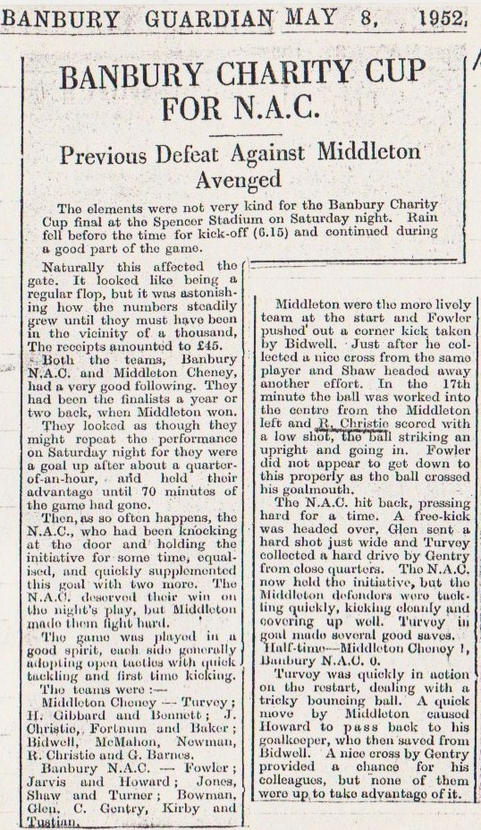
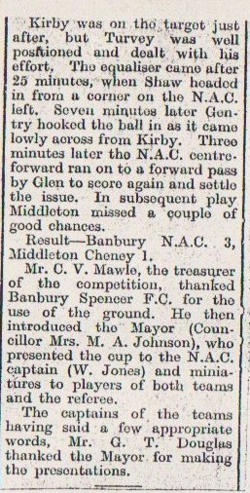
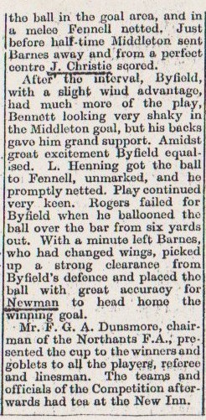

Slide 5
April 12th 1952 Byfield Bethel Cup Final Played at Byfield
Byfield 2 v 3 Middleton
R. Bennett
H. Gibbard
R. Humphries
T. Killpack
L. Fortnum
S. Baker Goal Scorer H. Gibbard (Pen)
J. Christie J. Christie
T. McMahon R. Newman
R. Newman
G. Barnes
R. Christie
Ref Mr Derbyshire

Slide 6
